Slide 1
Channel Estimation Using Deep learning in Underwater Acoustic Communication Systems
Members
Ajay Bingi 17EC210
Sunnyhith Yadlapalli 17EC154
Abhiram 17EC117
Under the guidance of
B Nagavel Assistant Professor,Nitk

Slide 2
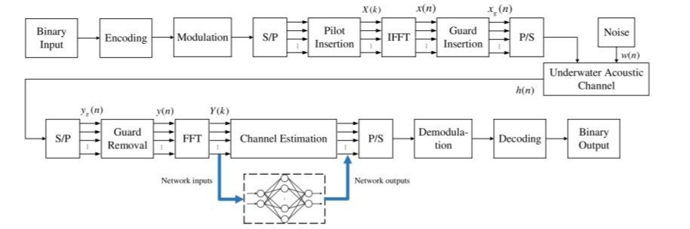
Problem Statement: Proposing a Deep Learning Model for the accurate Channel estimation In Underwater Acoustic Communication systems
Motivation :Underwater Acoustic (UWA) communication faces a lot of hurdles such as environmental characteristics, variety of noises, temperature, pressure, salinity, etc which makes the UWA channel unique.
Channel Estimation Model:

Slide 3
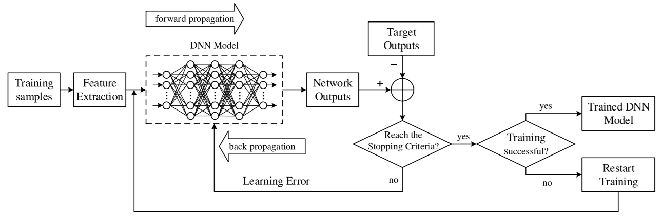
Deep learning Implementation:
Some Convolution Channel estimation methods
Least Square(LS)
Minimum mean square Error
Back propagation Neural networks
Expected Outcome:To get the maximum probable outcome by accurately predicting the impulse response of the channel.

